Slide 1


Campus Placement Portal
SDG 04 - Quality Education
Theme -
SDG 08 – Decent Work & Economic Growth
SDG 09 – Industry, Innovation & Infrastructure
SDG 11 - Sustainable Communities
Category- Software
Group No -08
Group Members-Aditya Ingale,Dhruv Jadhav,Atharv Kadam,Kalpesh Jangale
Guide- Prof.Vijaya Bharathi J
1

Slide 2
Introduction
1. Importance of Campus Placements
Campus placements plays vital role in shaping students' careers
They provide opportunities for employment and professional growth
2. Limitations of Traditional Systems
Placement processes are mostly manual
Time-consuming and prone to human errors
3. Poor Data Management
Data is scattered across spreadsheets and files
Difficult to organize,access, and maintain records
4. Communication Gap
Lack of proper communication between students and placement cell Leads to delays, confusion, and missed opportunities
2

Slide 3
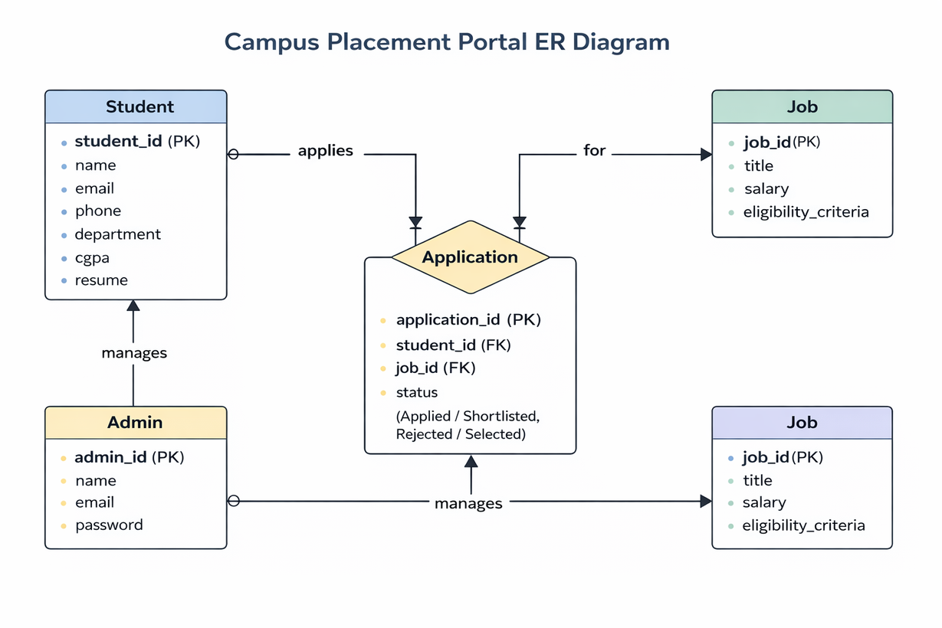
Overview of the System
3

Slide 4
Motivation & Objectives
Motivation
Simplify and automate manual placement processes
Centralize data for easy access and management
Improve communication between students and placement cell
Objectives
To develop an efficient placement management system
To provide student registration, job application, and tracking features
To enable smooth coordination between admin and students
To manage job posting effectively
4

Slide 5
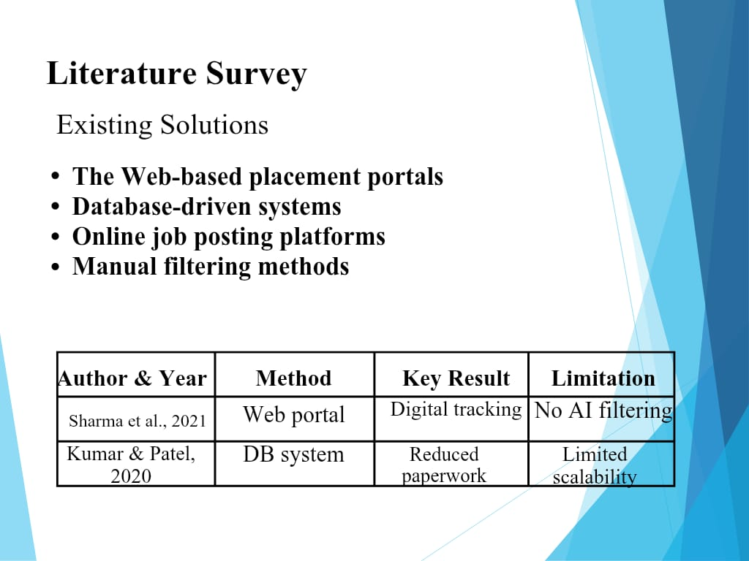
5

Slide 6
Limitations of existing Systems
1. Manual Processes
Time-consumingand prone to human errors
Increases workload for placement cell 2. Poor Data Management Data scattered across multiple files and spreadsheets Difficult to organize and retrieve information 3. Lack of Real-Time Updates Students do not receive timely notifications Causes delays in important information 4. Communication Issues Gap between students and placement cell Leads to confusion and missed opportunities
6

Slide 7
Problem statement
The existing campus placement process is manual and inefficient, with scattered data across multiple sources, poor communication between students and the placement cell, and lack of real-time updates, making it difficult for students to apply, track opportunities, and for administrators to manage the overall process effectively.
7

Slide 8
Proposed Methodology
Proposed Solution Overview:
Our project introduces a web-based Campus Placement Portal thathelps students and the placement cell manage placement activities digitally, streamlining applications, tracking, and communication in an organized manner.
Modules of the System:
Authentication Module (Login & Signup) – Secure access for students and admin.
Dashboard Module (Overview) – Admin: Placement statistics and updates; Students: Applied companies, upcoming drives.
Student Management Module – Students can register, update profiles, and apply for companies.
Application Tracking Module – Track application status, interview schedules, and notifications.
8

Slide 9
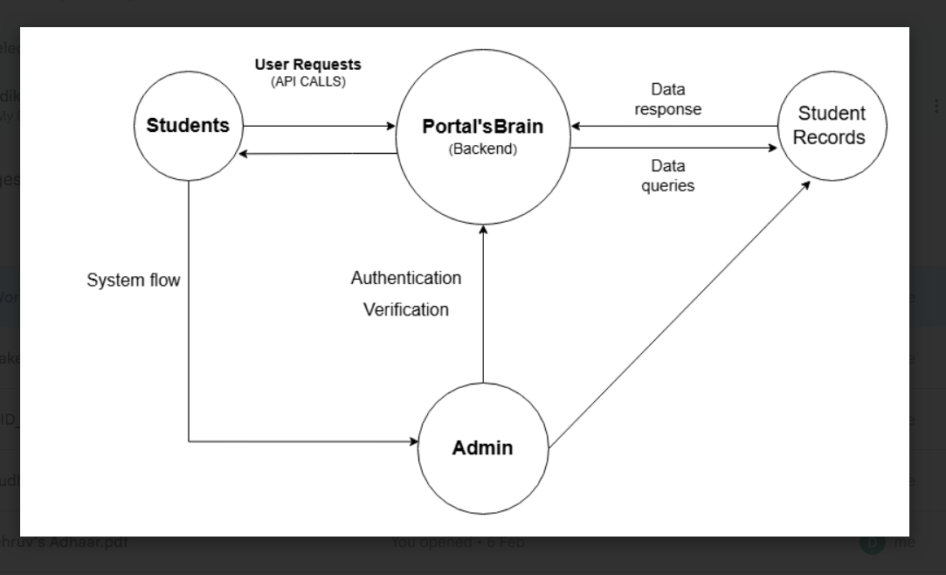
System Flow Diagram:
9

Slide 10



Experimental Setup
Technologies Used:
Frontend
: HTML,CSS, JavaScript
Backend :
Python,Flask framework
Database
: MySQL
Tools :
VSCode,Web Browser, MySQL Server
Hardware:
Intel core i5 - 12450HX
16 GB DDR4 RAM
10

Slide 11
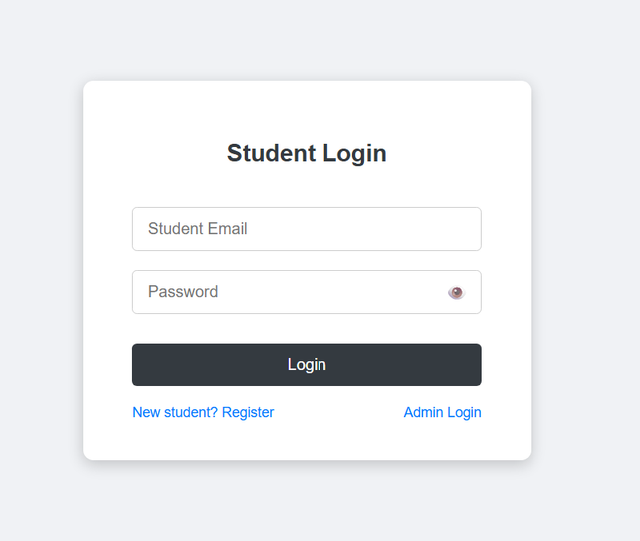
Implementation
Student Login
11

Slide 12
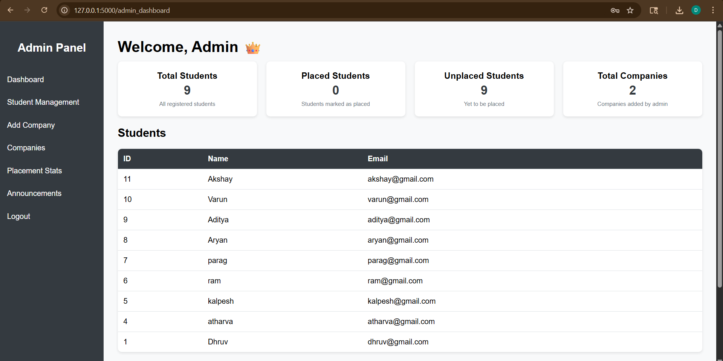
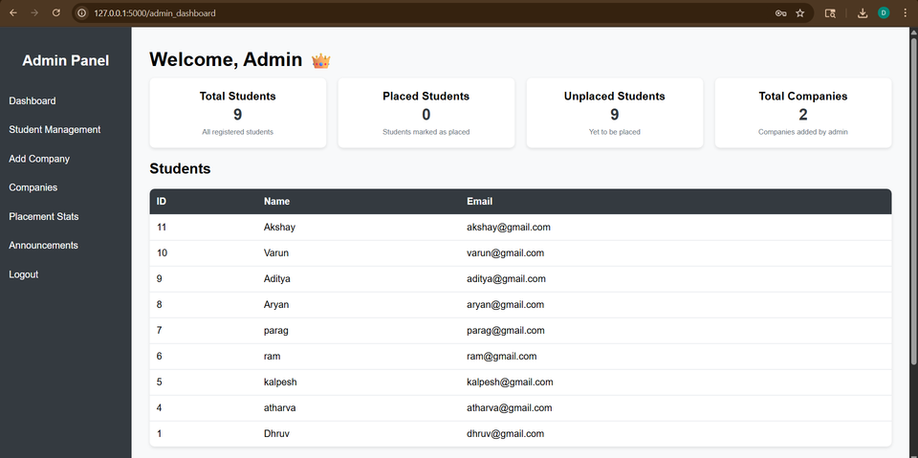
Implementation
12

Slide 13
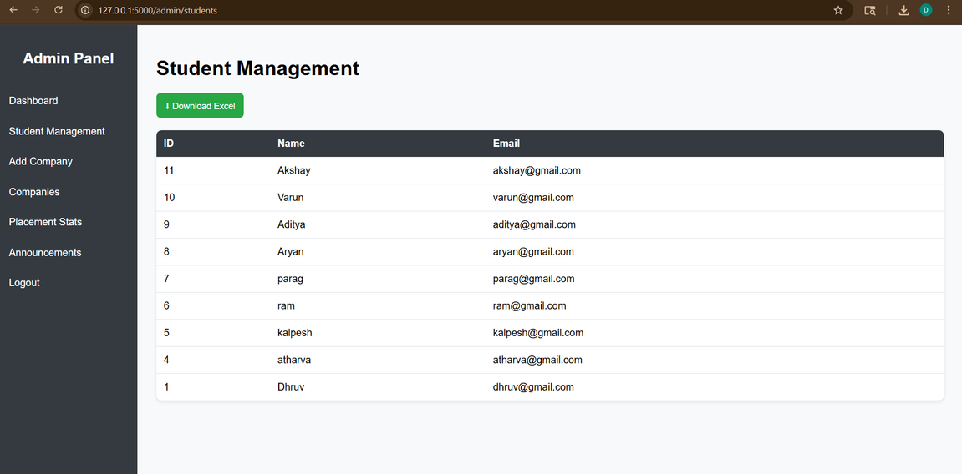
Implementation
13

Slide 14
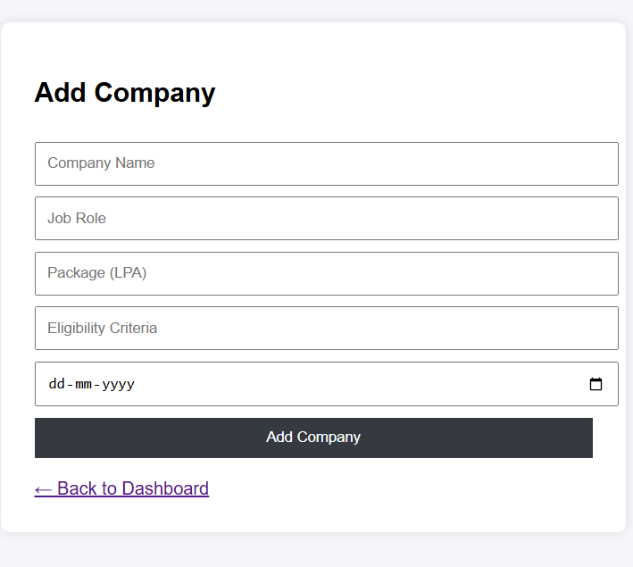
Implementation
14

Slide 15
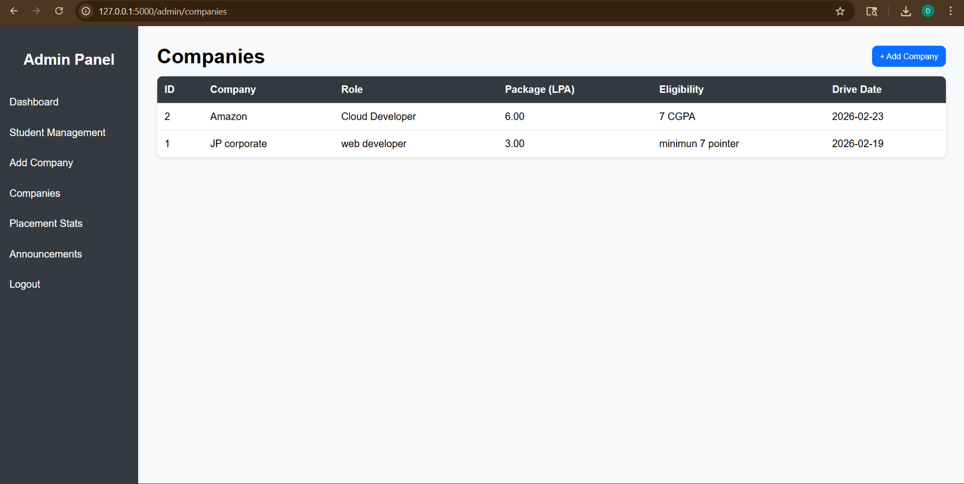
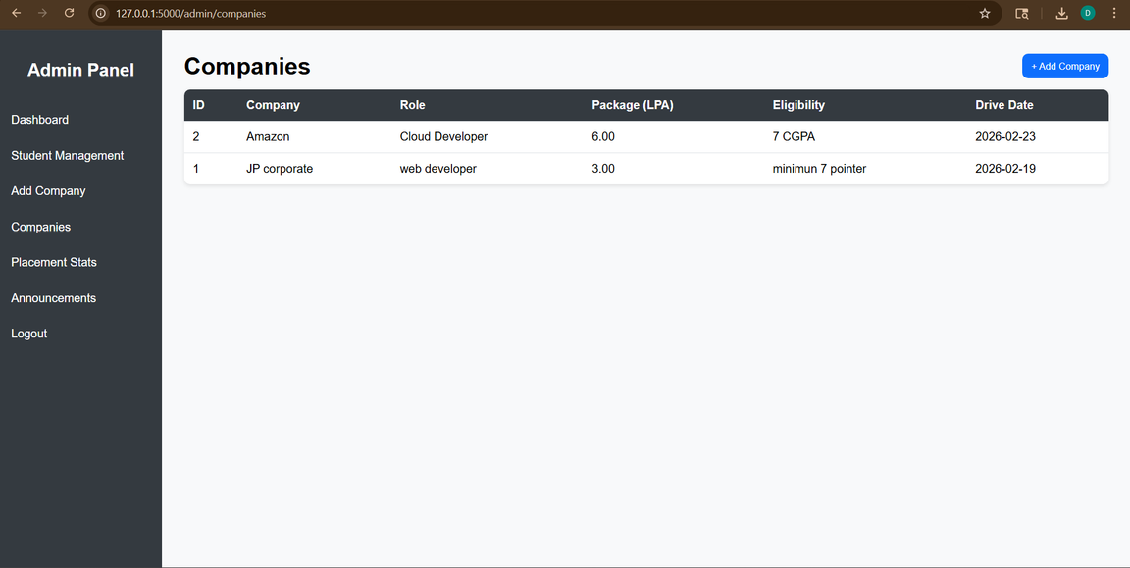
Implementation
15

Slide 16
Result & Analysis
Result Achieved
Reduce manual workload of the placement cell by approximately 60%.
Improved management and accessibility of student and company records.
Faster access to application and placement data Automated tracking of applications and notifications.
Analysis of the system
Dashboard provides real-time overview of placement activities Centralized digital storage minimizes risk of data loss Application tracking and history improve decision-making for students and admin Simplifies overall placement operations and communication
16

Slide 17
Conclusion and Future work
Conclusion: In conclusion,the proposed Campus Placement Portal
simplifies the placement process by providing a digital, organized, and efficient platform for students and placement cell administrators, improving application tracking, record management, and communication.
Future work
Integration with cloud storage for secure backup of student and company data Development of a mobile-friendly application for easier access by students and admins Automated email or WhatsApp notifications for application updates and interview schedules Graphical analytics of placements and application trends
17

Slide 18
References
References: [1] R. Sharma et al., “Web-based Placement System,” IEEE, 2021. [2] P. Kumar and S. Patel, “Automated Placement Portal,” Springer, 2020. [3] Python Software Foundation, Python Documentation, 2024 . [4] SQLite Documentation, 2024
18

Slide 19
Thank You...!!
19

